Slide 1







Real Estate Analytics
Team Members
Priya
Sharad Jha
Arunjyoti Sha
Sourashis Das
Md Aamir Khan
PS No.
10847983
10848073
10848133
10848172
10848238
Guided By:
Mr. Babjee Reddy
©LTIMindtree | Privileged and Confidential 2022
1

Slide 2






Problem and Project Overview
01
Data Processing and Insight Challenges
Manual and fragmented data ingestion processes
Inconsistent, duplicated, and non-standardized data
Limited visibility and delayed analytical insights
02
End-to-End Data & Analytics Platform
Automated data ingestion and transformation pipelines
Centralized cloud-based data warehouse
Interactive dashboards and analytics for business users
AI-assisted insights to support faster decision-making
Who the Solution Is For
03
Business analysts and decision-makers
Data and analytics teams
©LTIMindtree | Privileged and Confidential 2022
2

Slide 3
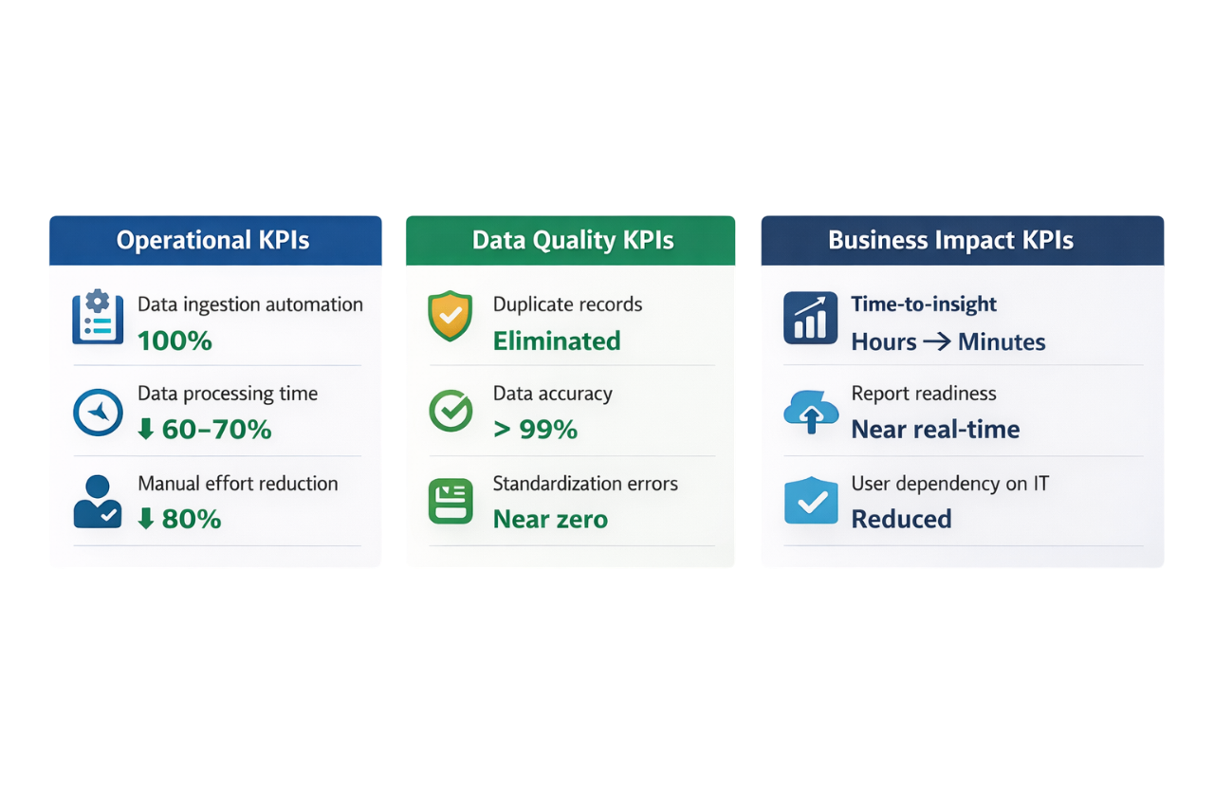
Business KPIs
©LTIMindtree | Privileged and Confidential 2022
3

Slide 4


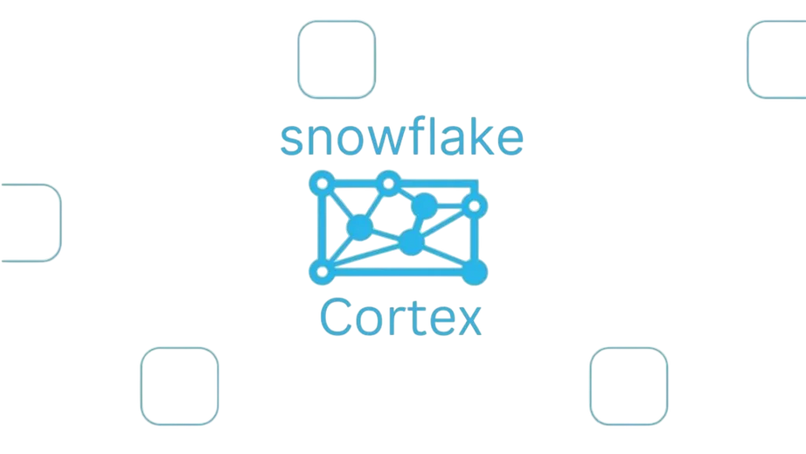



AWS S3
Snowflake
Technology
Used
Snowflake Cortex AI
Informatica IDMC
Streamlit
©LTIMindtree | Privileged and Confidential 2022
4

Slide 5
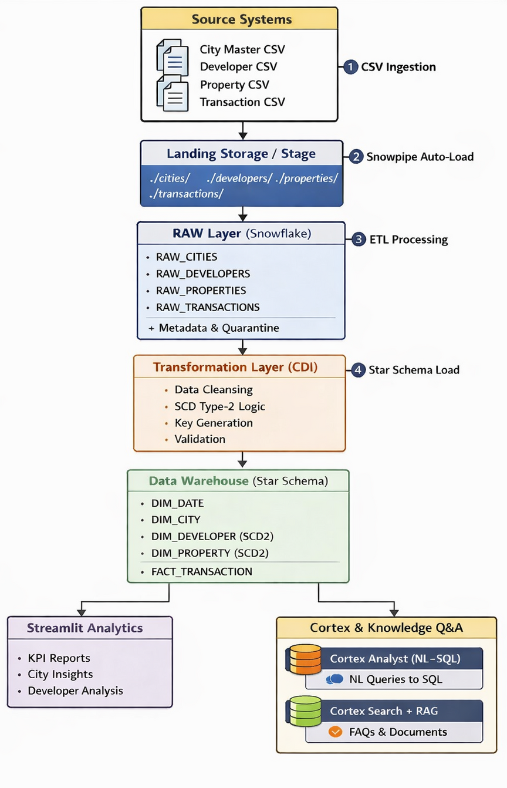

Data Flow Diagram
©LTIMindtree | Privileged and Confidential 2022
5
Notes:
5

Slide 6

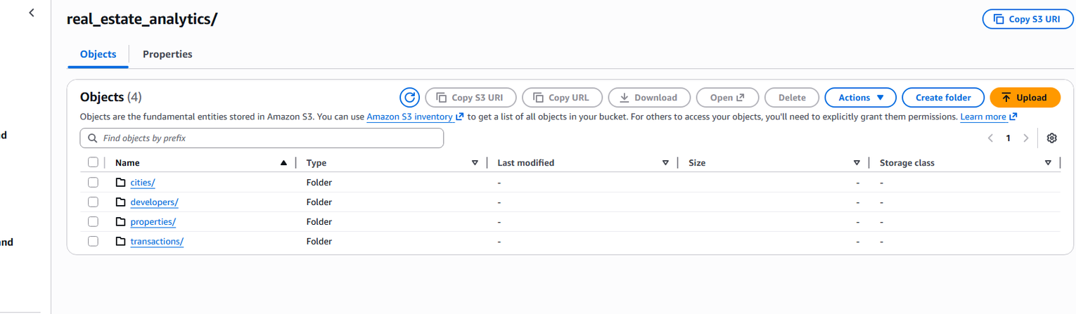
Data Ingestion
1. Data Loading:
CSV files like City, Developer, Property, and Transactions are ingested into Snowflake’s RAW layer using Snowpipe with no transformations to preserve source data.
2. Automation:
Snowpipe automatically detects and loads new files in near real-time, ensuring continuous and scalable ingestion.
3. Basic Validation:
We perform initial checks like schema validation and datatype consistency before moving data to the cleaning layer.
©LTIMindtree | Privileged and Confidential 2022
6
Notes:
5

Slide 7
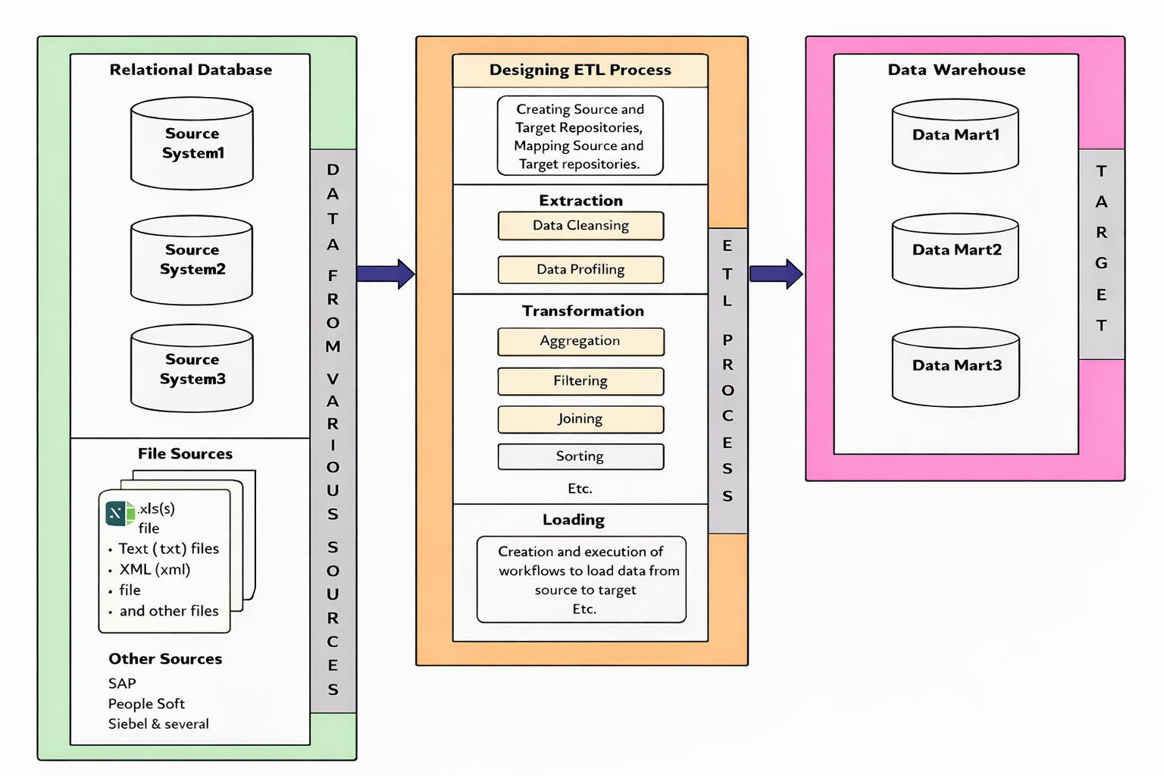
ETL
Data from RAW Snowflake tables is extracted and transformed using Informatica CDI for cleansing, standardization, and business rule application.
7

Slide 8
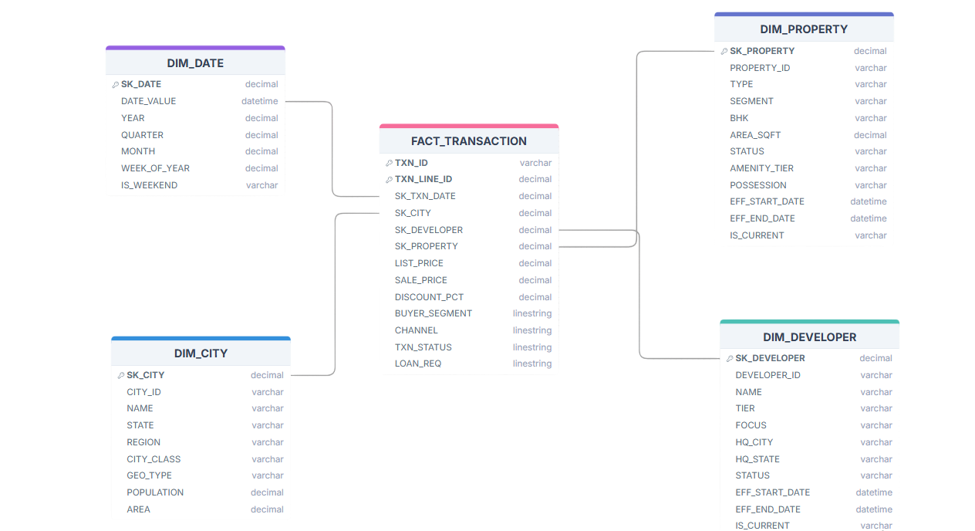

Schema Design
Benefits
Simple and intuitive data model
Faster query performance with fewer joins
Optimized for BI and reporting tools
Easy slicing and dicing of data
Efficient aggregation for KPIs
Simplified ETL and maintenance
Scalable for large data volumes
Supports SCD for historical tracking
8

Slide 9
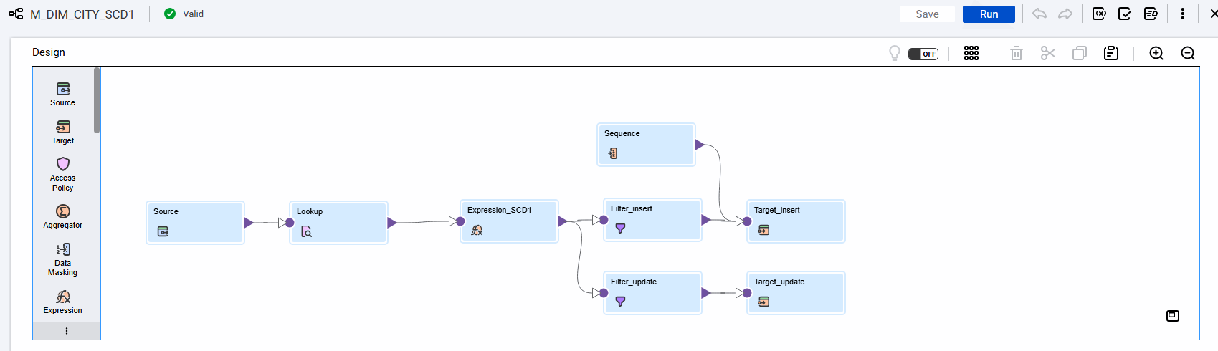
Slowly changing dimensions Type 0 (SCD 0) for date:
DIM_DATE is a static dimension, so instead of loading it from a source system, it is generated programmatically using a recursive query.
Slowly changing dimensions Type 1 (SCD 1) mapping for cities:
9

Slide 10
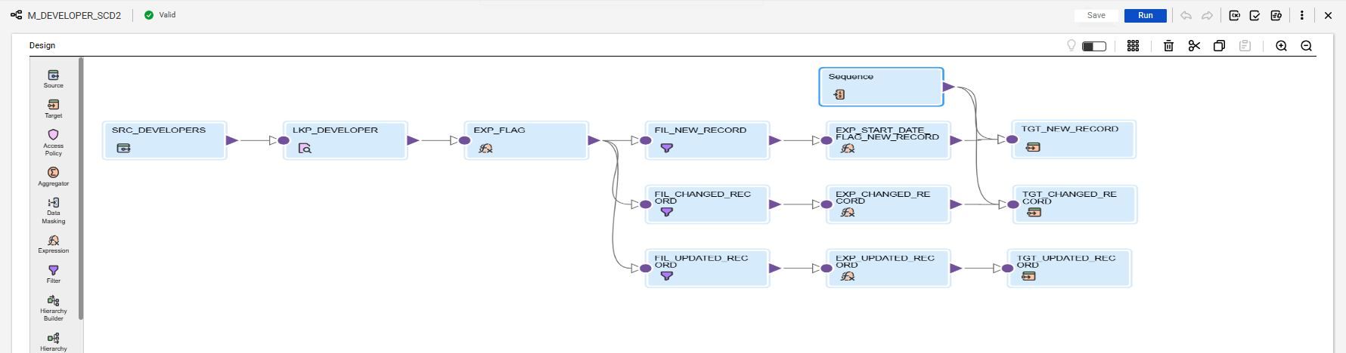
Slowly changing dimensions Type 2 (SCD 2) mapping for property and developer:
Developer mapping:
10

Slide 11
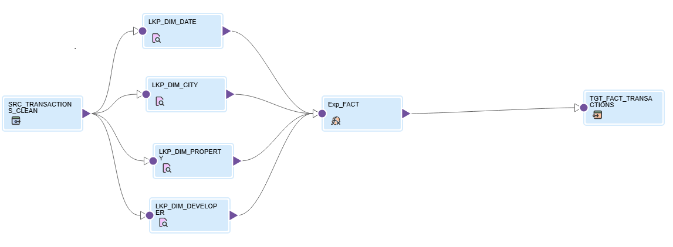
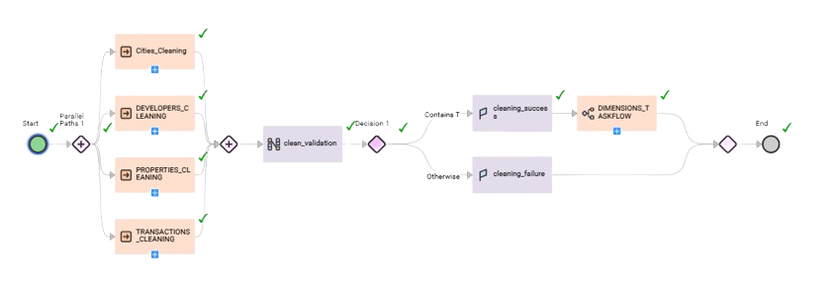
Fact Table Mapping for transactions:
Table Cleaning TaskFlow:
11

Slide 12
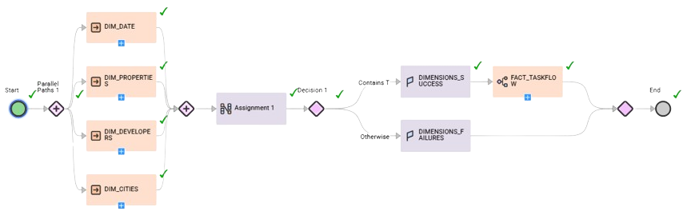
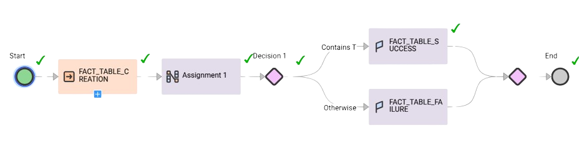
Dimensional Tables Creation TaskFlow:
Fact Table Creation TaskFlow:
12

Slide 13
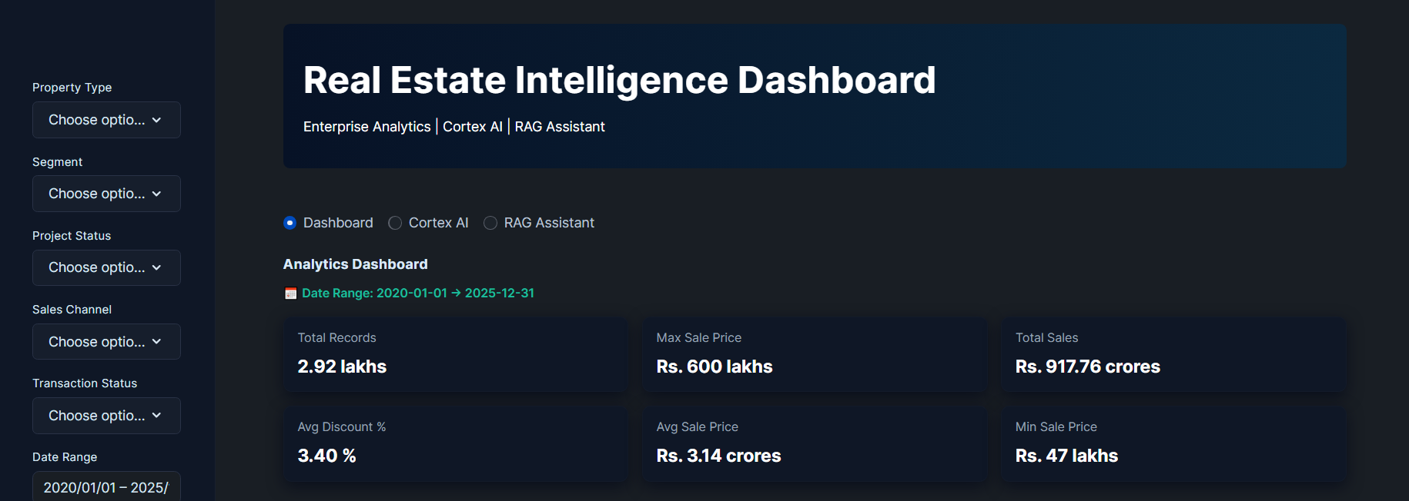
Streamlit
13

Slide 14
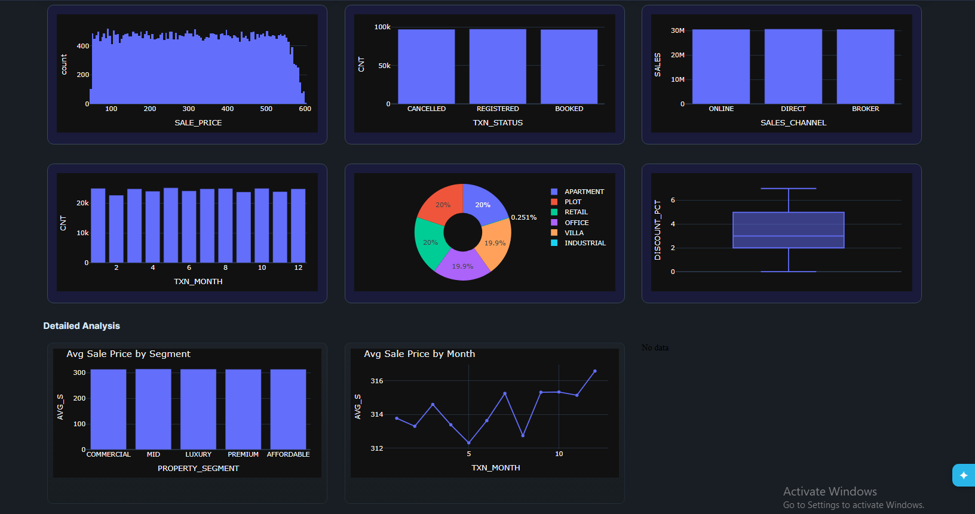
14

Slide 15
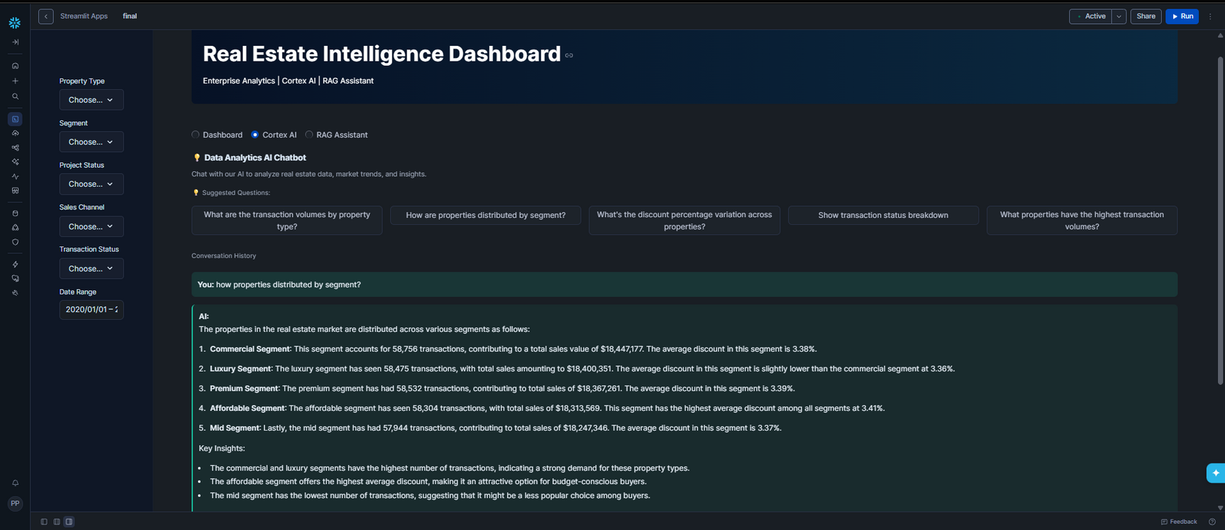
Cortex AI
15

Slide 16
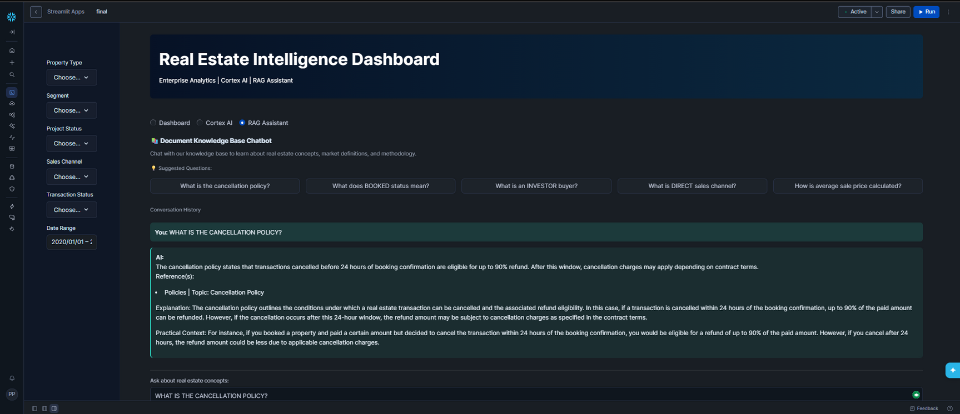
RAG (Retrieval Augmented Generation)
16

Slide 17

THANK YOU
LTIMindtree Limited is a subsidiary of Larsen & Toubro Limited
17

